Slide 1
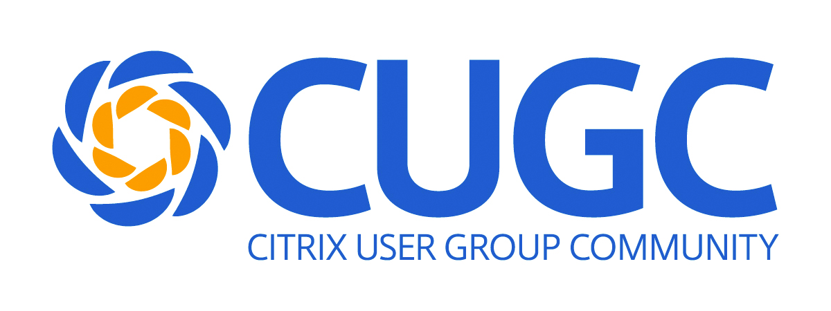
Microsoft Containers in a Citrix World
Mike Nelson, Andrew Wood
August 2017

Slide 2
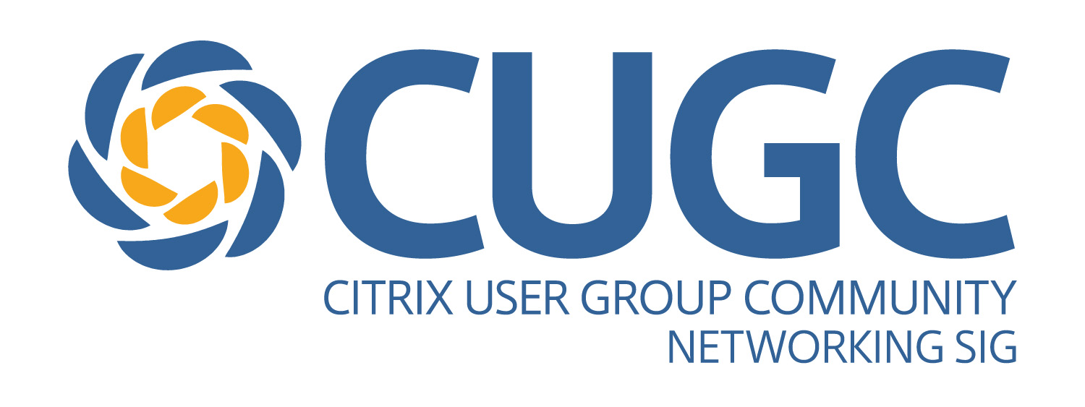

Mike Nelson
Infrastructure Architect
Citrix CTP
Microsoft MVP
Microsoft Azure Advisor
VMware vExpert
@nelmedia
nelmedia@gmail.com

Slide 3

Andy Wood
Principal Architect
Citrix CTP
VMware vExpert
CEng, CITP
@andymwood
www.gilwood-cs.co.uk

Slide 4
Topics
Windows and Docker
Containers and Citrix
Some Alternatives

Slide 5

Notes:
The new Windows Containers logo

Slide 6
Why Are YOU Here?
DevOps or ITPro?
“As a system Administrator, one of the scariest things I ever encounter is a server that has been running for ages.
If you absolutely know a system has been created via automation and never changed since the moment of creation, most of the problems disappear.”
- Chad Fowler, Trash Your Servers and Burn Your Code, 2013

Slide 7
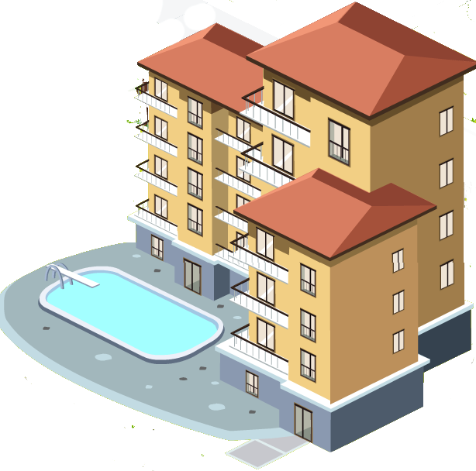

VMs and Containers
VM’s
Containers
“Will containers replace VM’s?”
No.
Containers are not a virtualization technology.
Containers are an application deployment & delivery technology.

Slide 8
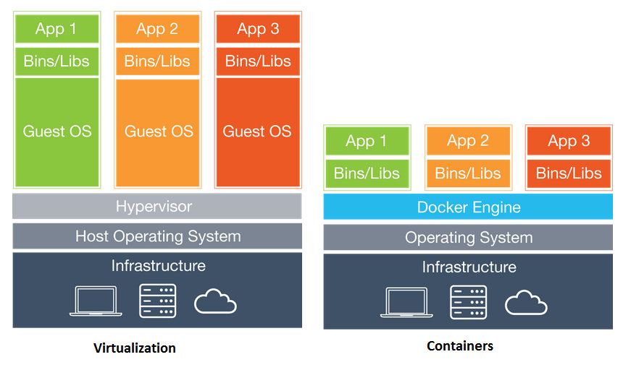
Notes:
Build versions limitations

Slide 9
A Microsoft View of Containers
Containers = Operating system virtualization
Windows Server Containers
Maximum speed and density
OS
CONTAINER
CONTAINER
CONTAINER
CONTAINER
CONTAINER
CONTAINER
Applications
Kernel
Kernel
Hardware
Hyper-V Containers
Isolation plus performance
Traditional virtual machines = hardware virtualization
Application
VM
VM
VM
CONTAINER
CONTAINER
CONTAINER
OS
Kernel
Kernel
Kernel
Hardware
Hyper-V

Slide 10
Windows Containers – It’s All About User Mode
Host User Mode
Virtual Machine Specifically Optimized To Run a Container
System Processes
Container Management
Session Manager
Hyper-V Container
Docker Engine
Local Security Authority
Windows Server Container
Windows Server Container
Compute Services
Etc…
System Processes
Application Process(es)
System Processes
Application Process(es)
Windows Kernel
Windows Kernel

Slide 11
Windows Server & Hyper-V Containers Mix
Linux Container
Linux Container
Linux Container
Linux Container
Hyper-V Container
Hyper-V Container
Hyper-V Container
Hyper-V Container
Windows Server Container
Windows Server Container
Linux Container
Linux Container
Linux Container
Linux Container
Linux Container
Windows Server Container
Windows Server Container
Hyper-V
Hyper-V
Server 2016
Windows 10
Linux
Hyper-V
Hyper-V
Physical / Azure / Azure Stack
Hyper-V = Different OS Releases and Builds
Server OS = Release version must be the same, while Build version can be different

Slide 12
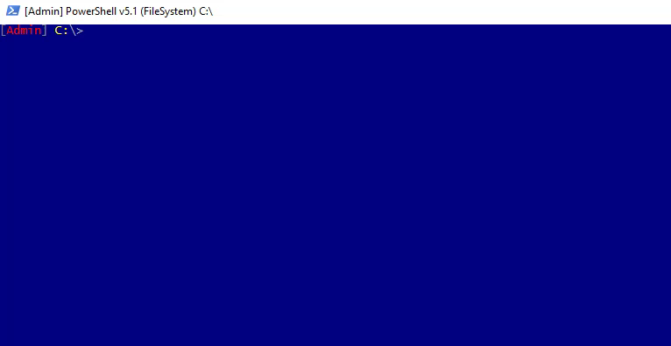
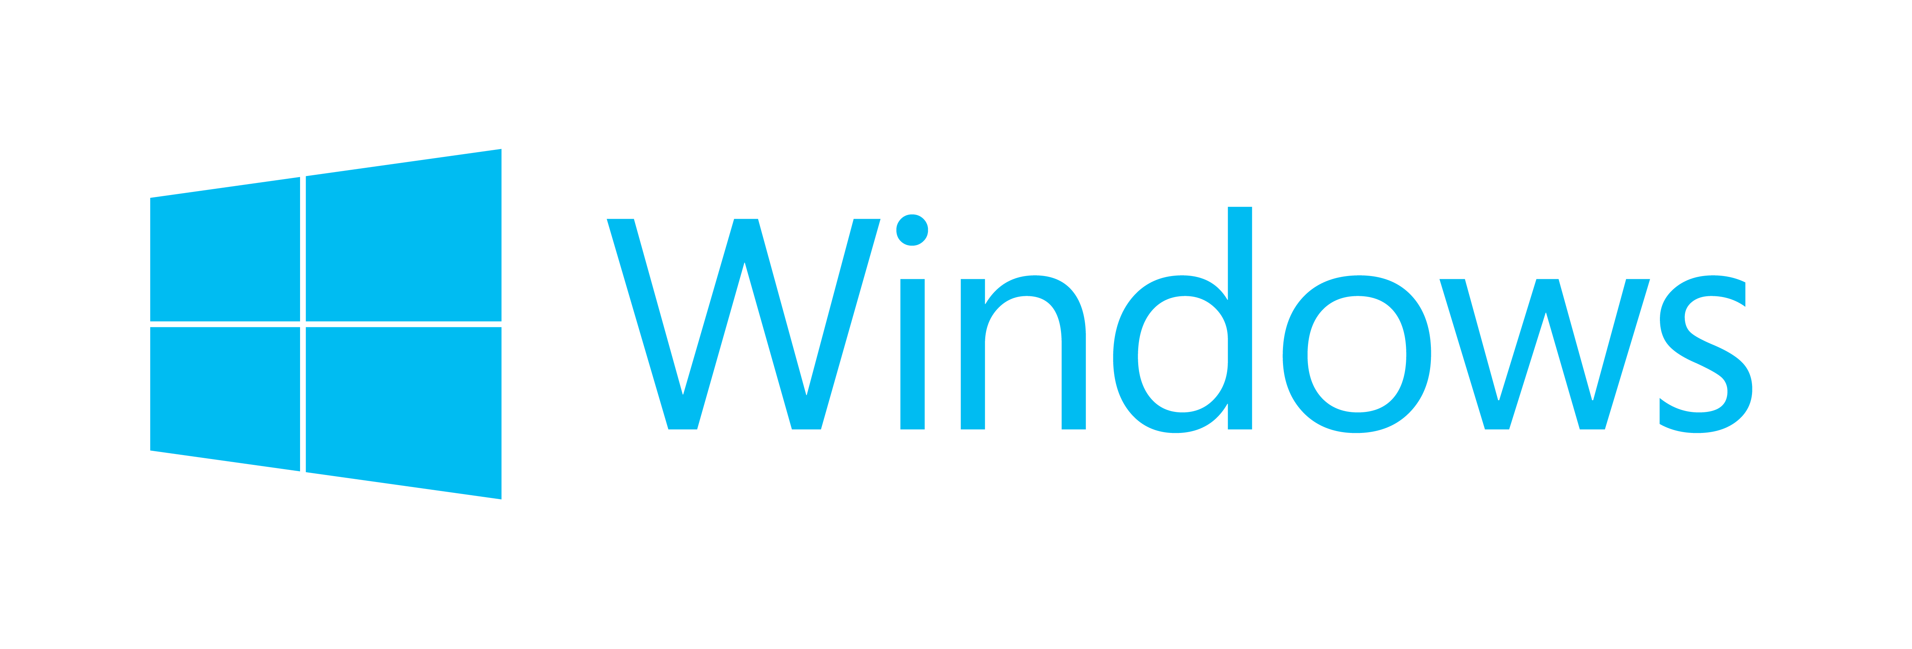


Dockercon 2017
+
+
Notes:
LinuxKit
Secure, Lean, & Portable Linux subsystem
Tooling to build custom Linux subsystems that only includes exactly the components the runtime platform requires
~35MB in size, very quick start
All system services are containers and can be removed or replaced
Will most likely start as a feature element of Windows Server and grow into a native service.
Follows NIST draft of Application Security Guide

Slide 13


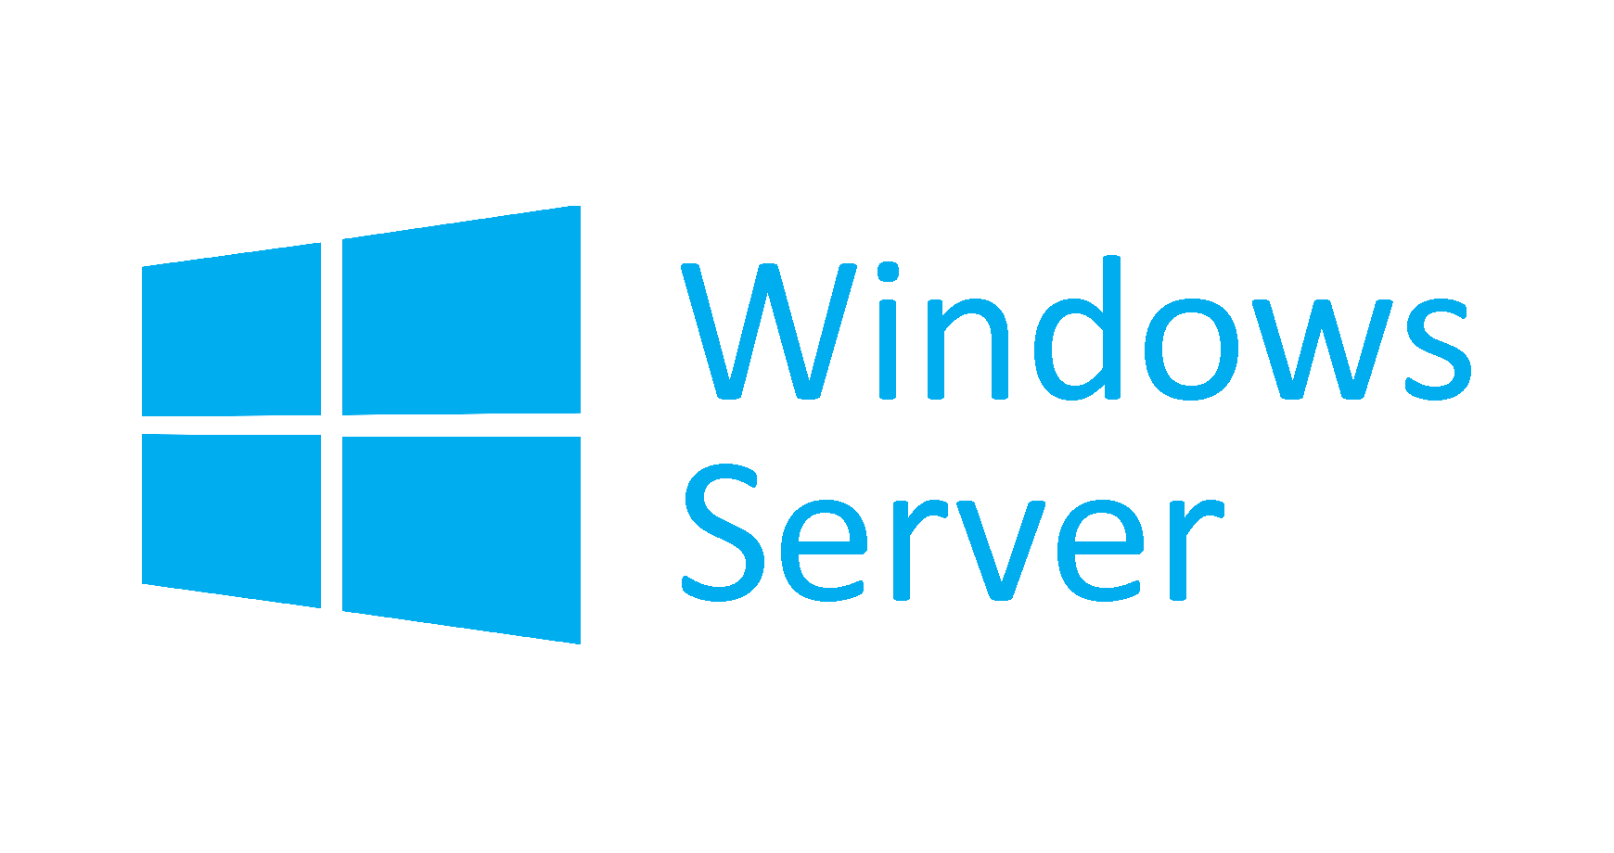

+
+
NanoServer
Core

Slide 14
Docker on Windows
Server Core & Nanoserver only (for now…)
Management
Built-In Docker CLI & PowerShell
Kitematic, Portainer, Panamax, Simple Docker UI, Shipyard (Linux)
Public or Private Hubs & Registries
Windows 10 for DEV/Test

Slide 15
Install Demo
Docker for Windows 10 & Server 2016

Slide 16


Slide 17
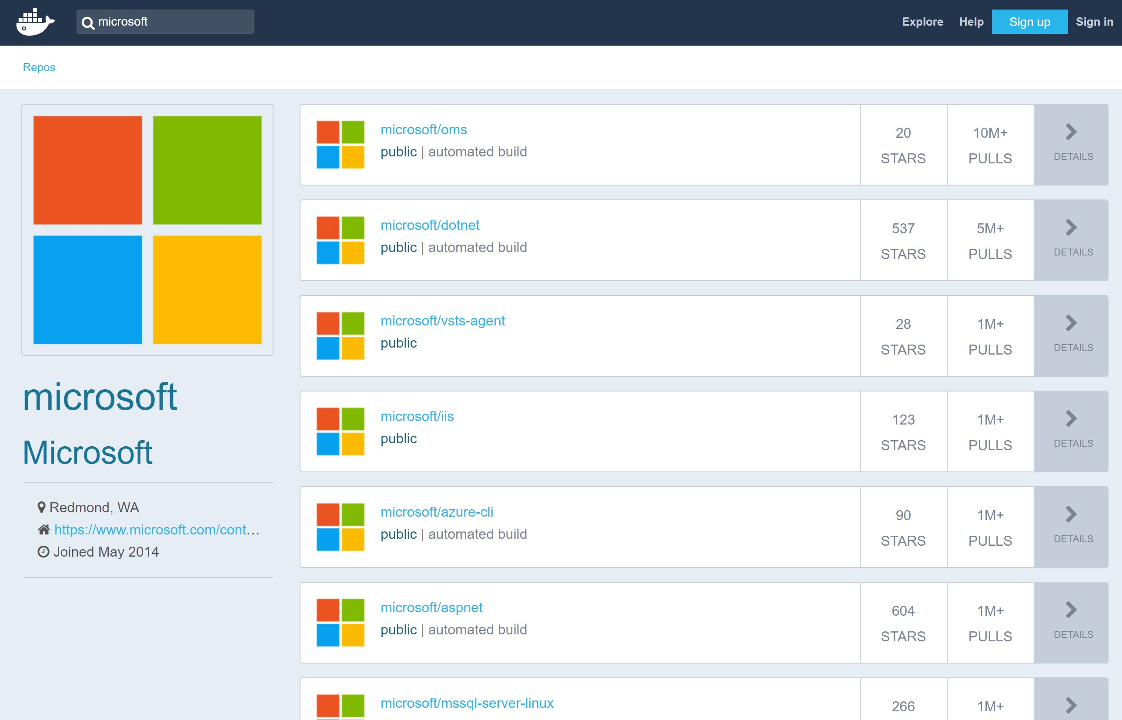
Linux Containers
Windows Containers
Build Version Limitations

Slide 18
Using Containers
Can I run the “Control Plane” in Containers?
How about Desktops?
And then there are the apps.

Slide 19
Windows Containers & GUI Apps
GUI
Notes:
Windows Containers rely on user space isolation implemented in the kernel (beginning with Windows Server 2016). While this allows for a more effective isolation, this only addresses server applications and does not allow for the graphical user interface of an end user applications to be presented.
Obviously not so much for mac/linux - https://blog.jessfraz.com/post/docker-containers-on-the-desktop/
.. I am using the Apple App Sandbox as an example so people can grasp the concept easily. I am not saying this is exactly like that and has all the features. This is not a sandbox. It is more like a cool hack.
I hate installing things on my host and the files getting everywhere. I wanted the ability to delete an app and know it is gone fully without some random file hanging around. This gave me that. Not only that, I can control how much CPU and Memory the app uses. Yes, the cpu/memory hungry chrome is now perfectly contained!
“What?!?!”, you say. Let me show you

Slide 20
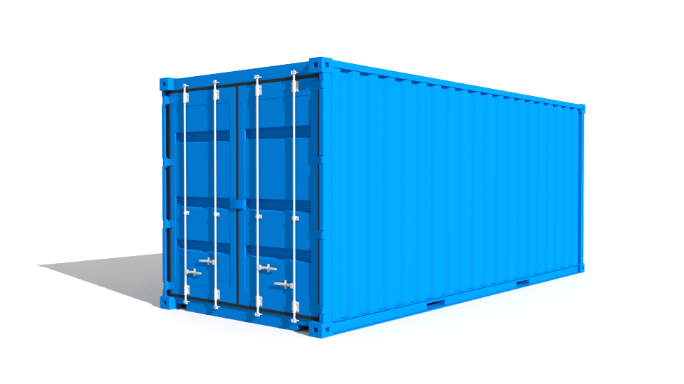


Containers Running XenDesktop & XenApp
Control Plane
SQL
License
Director
DDC
Studio
Optional
Storefront
Netscaler
XenApp
XenDesktop
Apps

Slide 21
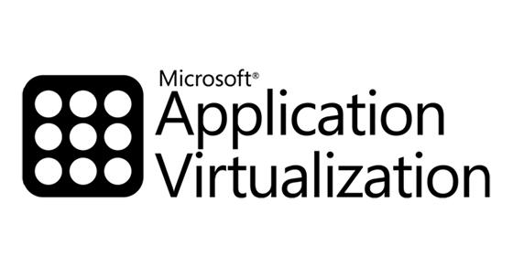
“… Docker containers does encapsulate all the code and libraries necessary to run a service. But those services are fundamentally different than the applications that are delivered via traditional application virtualization technologies.
In the end Docker is not a direct replacement for application virtualization. It’s a way to take many of the applications deployed using app virt technologies and recreate them in a manner that offers higher levels of agility, portability, and control.” – Mike Coleman, Technical Evangelist @ Docker
Notes:
https://msandbu.wordpress.com/2016/02/05/application-virtualization-vs-application-layering/
Important to remember that AppVirt runs in user-space, and therefore there are some restrictions to what it can run (Antivirus, VPN, Boot stuff, Kernel Stuff, Drivers and so on). Application virtulization should be used for the following:
Application Isolation
Mutliple runtime versions
Streaming to non-persistent
Application compability

Slide 22
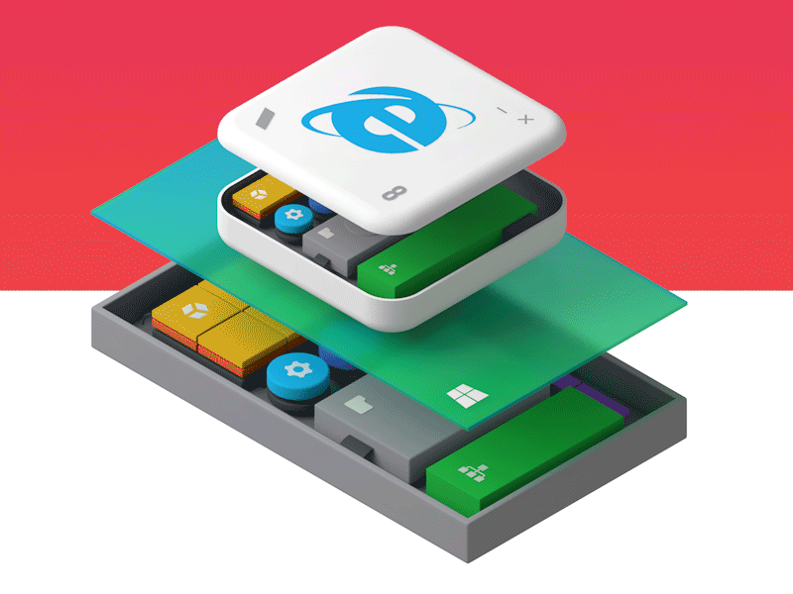
Notes:
https://msandbu.wordpress.com/2016/02/05/application-virtualization-vs-application-layering/
Application layering is a bit different, it basically uses a filter driver to merge different virtual disks which will then make up a virtual machine. Application layering should be used for the following:
Application lifecycle management
Image management
Profile management (if supported by vendors)
Applications which require drivers / boot stuff
And lastly, what is coming in the future? Most likely this will be container based applications, which have their own networking stack, more security requirements and contained within their own kernel space. Here we have providers such as Turbo.net which have been delivering container based applications before Windows Announced container support for their operating system

Slide 23

“Containers” similar to Docker
Pre-made or custom images
CLI, Turbo Studio, Turbo Server
Updating & Layering
Importing from other formats
Container “skinning” & streaming
Desktop & server apps – XP to 2016 & beyond
turbo.net
Turbo Studio
Virtualize app into EXE & publish - manual or via Register utility
Register utility allows for app to be placed on machine or share & in 7.x it will appear in Citrix Studio Wizard
Spoon.net
“Docker for Windows”
- Rory Monaghan 2014
“XenApp Subscription”
Channel -> Subscribe -> Publish
XenApp Tools to automate setup are provided
https://github.com/turboapps/citrix
www.xenappblog.com
Notes:
http://rorymon.com/blog/?p=3768
Introduction
For anybody who is not familiar with Turbo.net and their Turbo Containers let me explain. Turbo.net is the quickest way to get the applications you need and want on your Windows system. Turbo.net has over 1k applications created and maintained by their team.
The applications are containerized, meaning though they run and work just like any application on your system, they actually run isolated within their own secure environment. This is awesome because it prevents these applications from conflicting with other applications on your system. You can also run multiple versions of the same application side by side on your system without issue e.g. you can run Internet Explorer 8 and Internet Explorer 11 on the same Windows 10 system.
http://ohmag.net/?p=1800
Turbo containers are based on the Spoon VM which can trace it’s origin back to 2006 when Kenji Obata founded the Code Systems Corporation, which is still the company behind Turbo today.
Turbo.net let’s you run Windows applications on all your PCs or remotely in the cloud. From the desktop point of view Turbo comprises an installable client which runs on all desktop versions of Windows since XP as well as Windows Server 2008 R2 onwards. So Turbo is an Apple and Linux free zone!
Turbo is a completely user mode system in that it does not run in the kernel using device drivers nor requires administrative privileges to use Turbo.net or run Turbo applications, even if the containerised application requires privileges. A container is a lightweight implementation of core operating system APIs, including the filesystem, registry, process, and threading subsystems.
Applications executing within this virtual environment interact with a virtualised filesystem, registry, and process environment, rather than directly with the host device operating system. The virtualisation engine handles requests within the virtualised environment internally or, when appropriate, routes requests to the host device filesystem and registry, redirecting or overriding requests as determined by the virtual application configuration. [please read Spoon Virtualisation for further information]. Containers can also contain standalone .NET and Java runtimes. Turbo has no dependence on any other virtualisation technologies for Windows, not even Hyper-V.

Slide 24
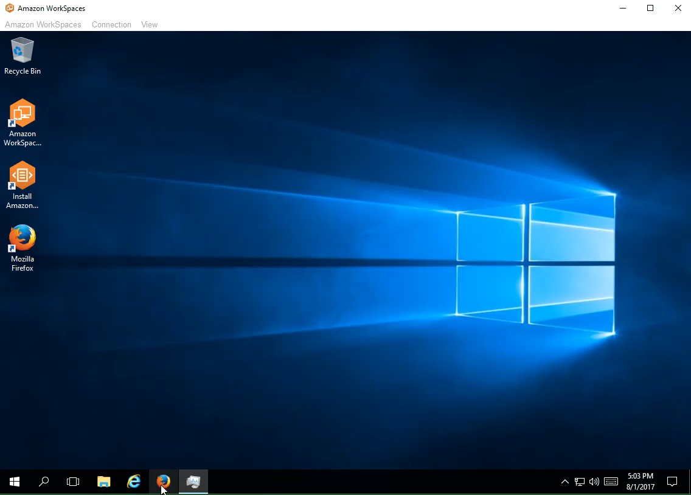

Slide 25
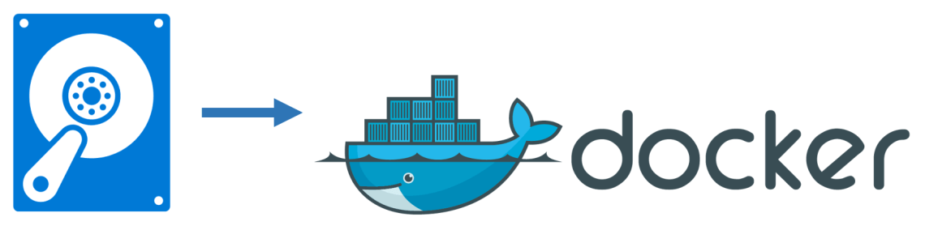
Image2Docker
PoSH module that ports existing Windows app artifacts from VM’s to Docker images
Artifacts currently supported –
IIS
ASP.NET
MySQL, SQL
Windows Features
Apache
DHCP
DNS
MSMQ
Discover -> Extraction -> Provisioning -> Generation

Slide 26
Containers are not VM’s (and never will be)
OS & GUI Limitations
Use Win 10 Docker for Dev/Test
There are alternatives for delivering apps
Windows + LinuxKit = Multi-Platform
Containers are about User Mode
Hyper-V for secure container isolation
Citrix needs to support Core

Slide 27
Thank You!

